Slide 1

Quiz Game App
PRESENDTED BY: ZHILIANG WANG
COMP5216 MOBILE COMPUTING

Slide 2
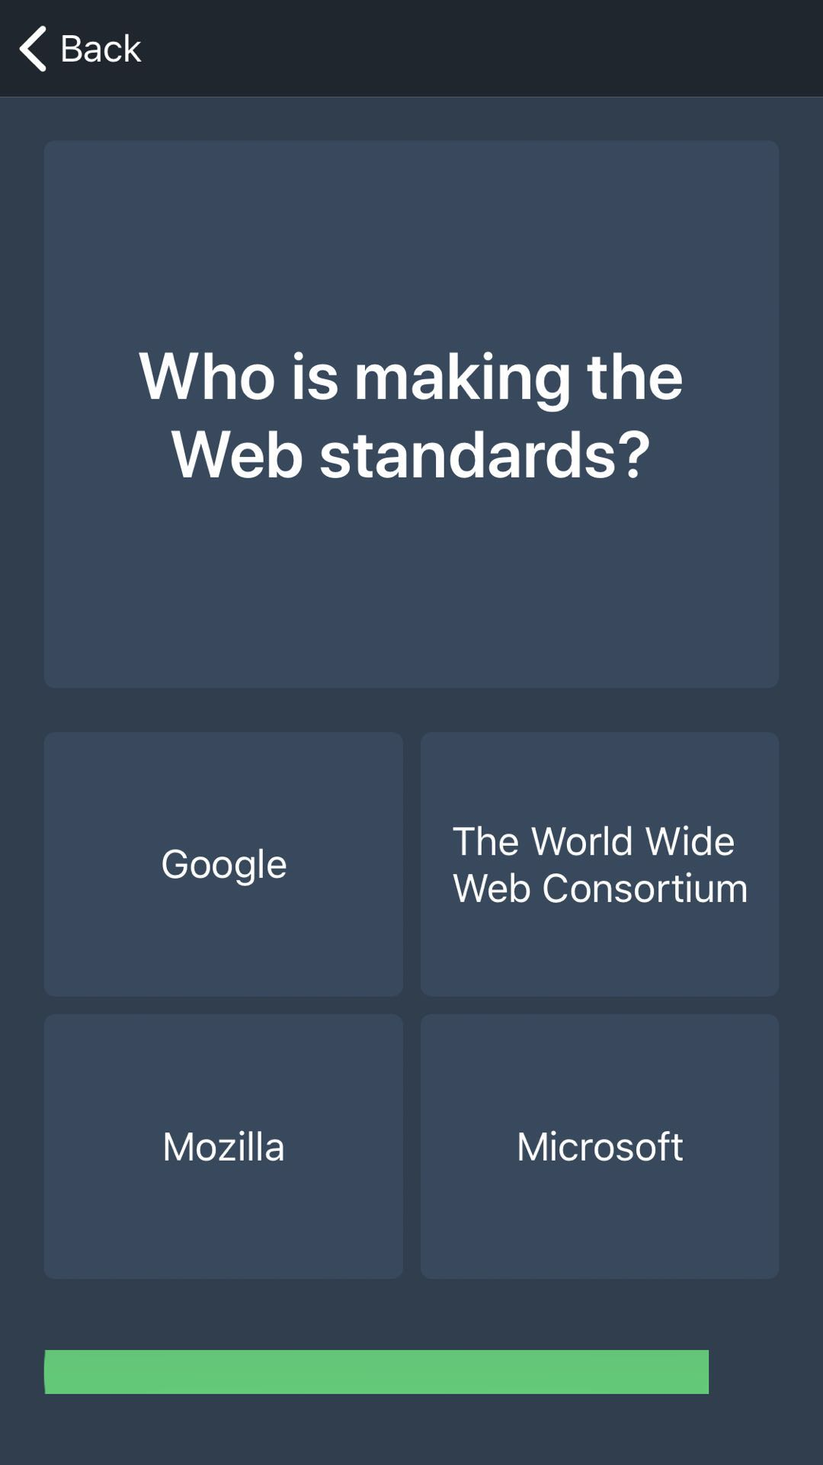
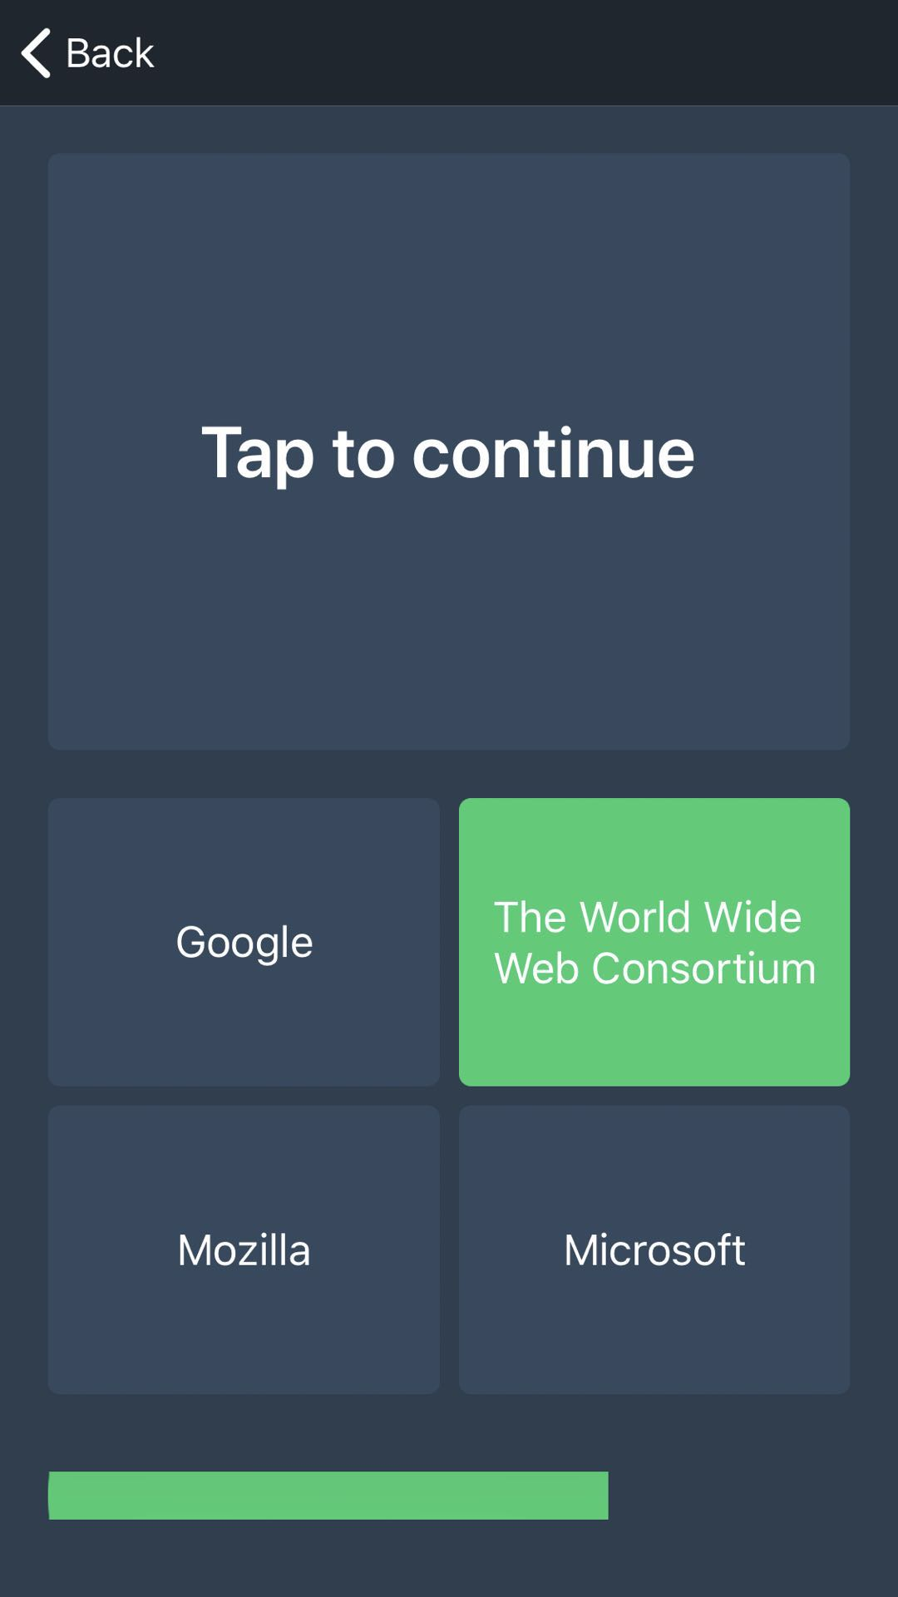
Quiz Categories
Multiple Choice Quiz
When the users entered MC Quiz,
they should select one correct answer
from four options. If they give the
wrong answer, MC quiz will quit and
back to app homepage.
When the user give the right answer,
MC quiz will continue by tapping upper section button.

Slide 3
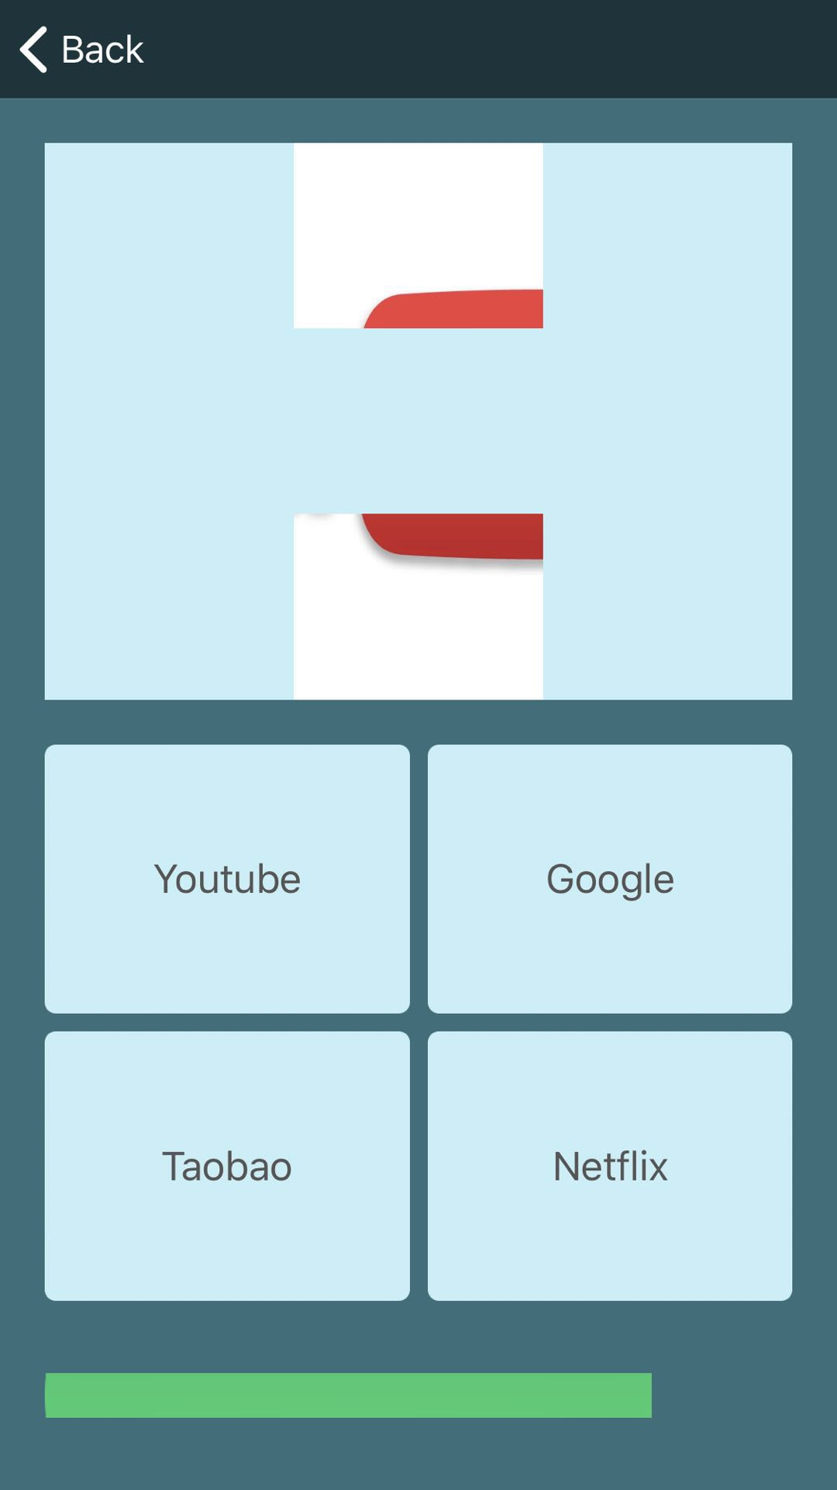
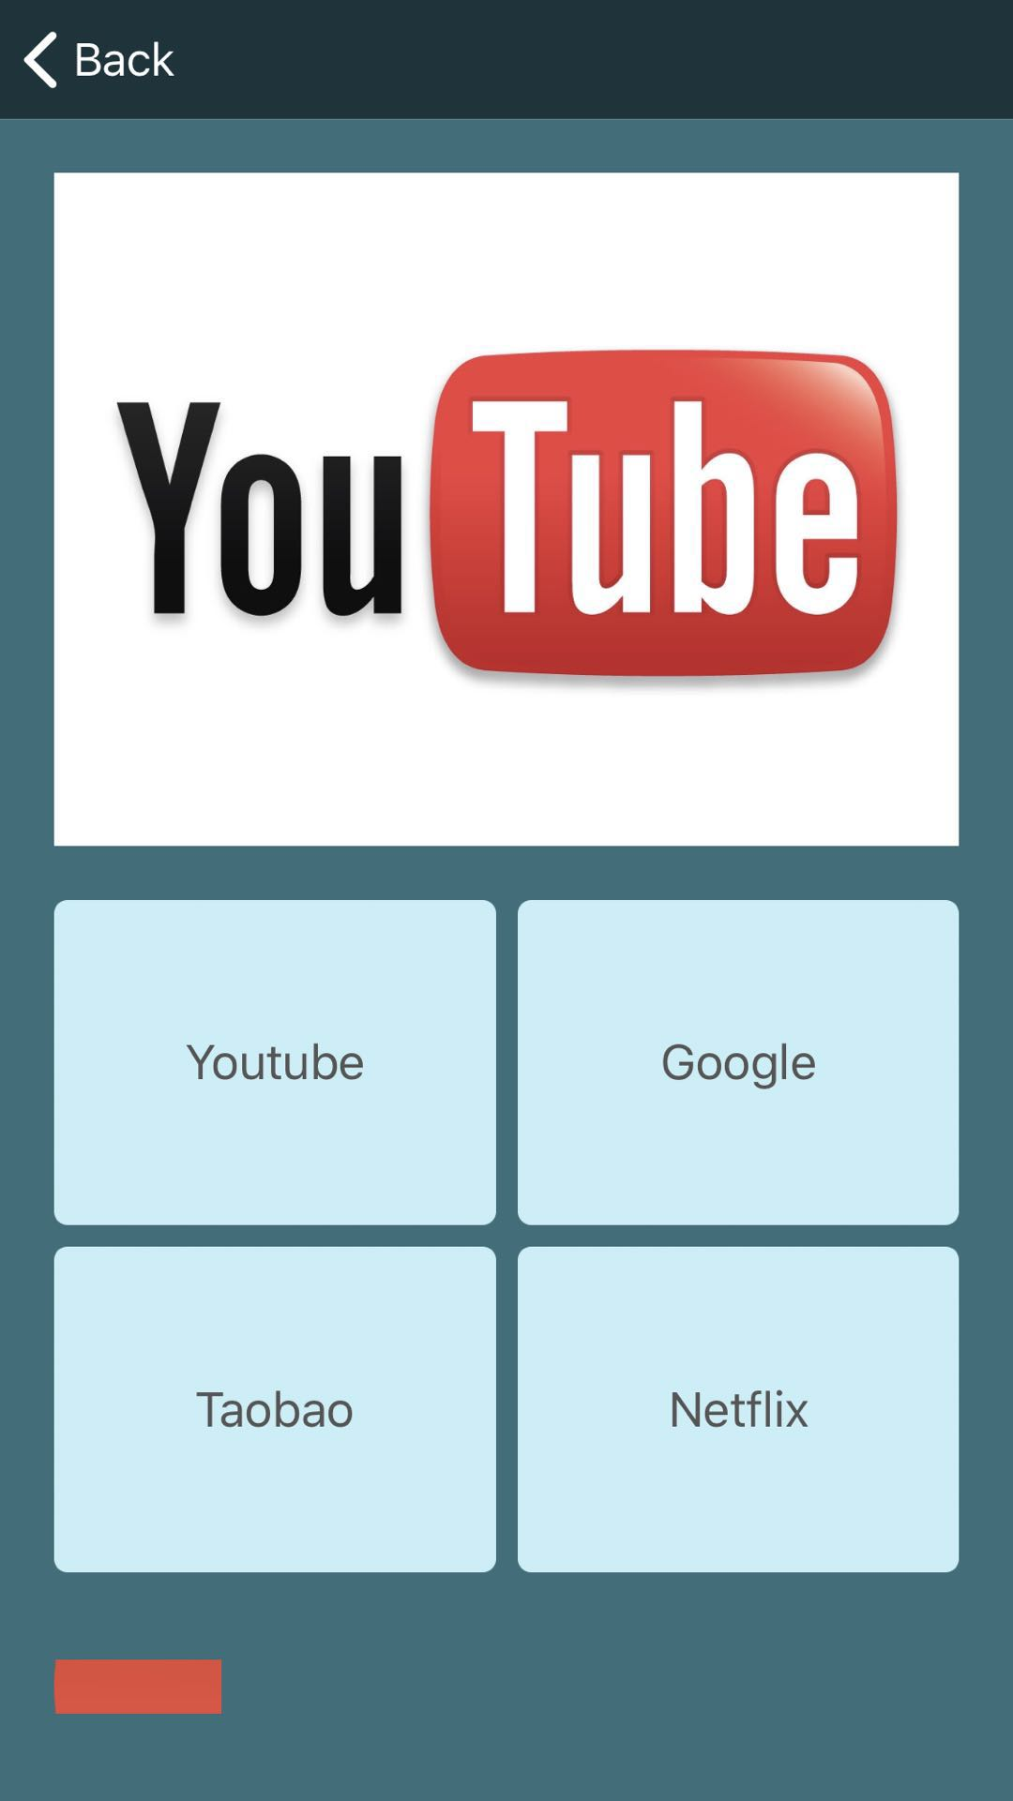
Quiz Categories
Images Quiz
When the user entered Image Quiz, they should select correct description of the image ASAP.
When the user give the right judgement on the image, image quiz will continue automatically.

Slide 4
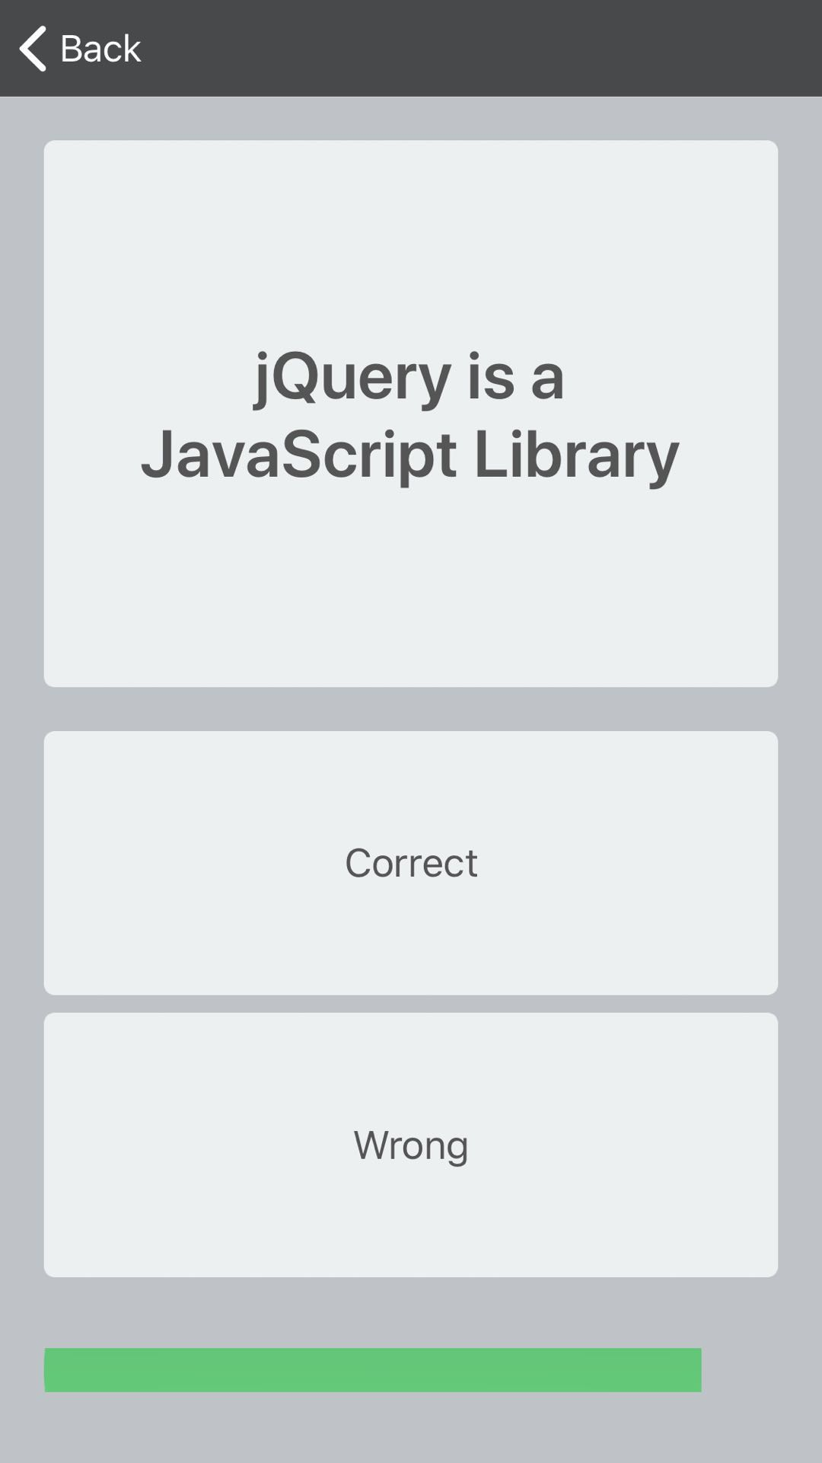
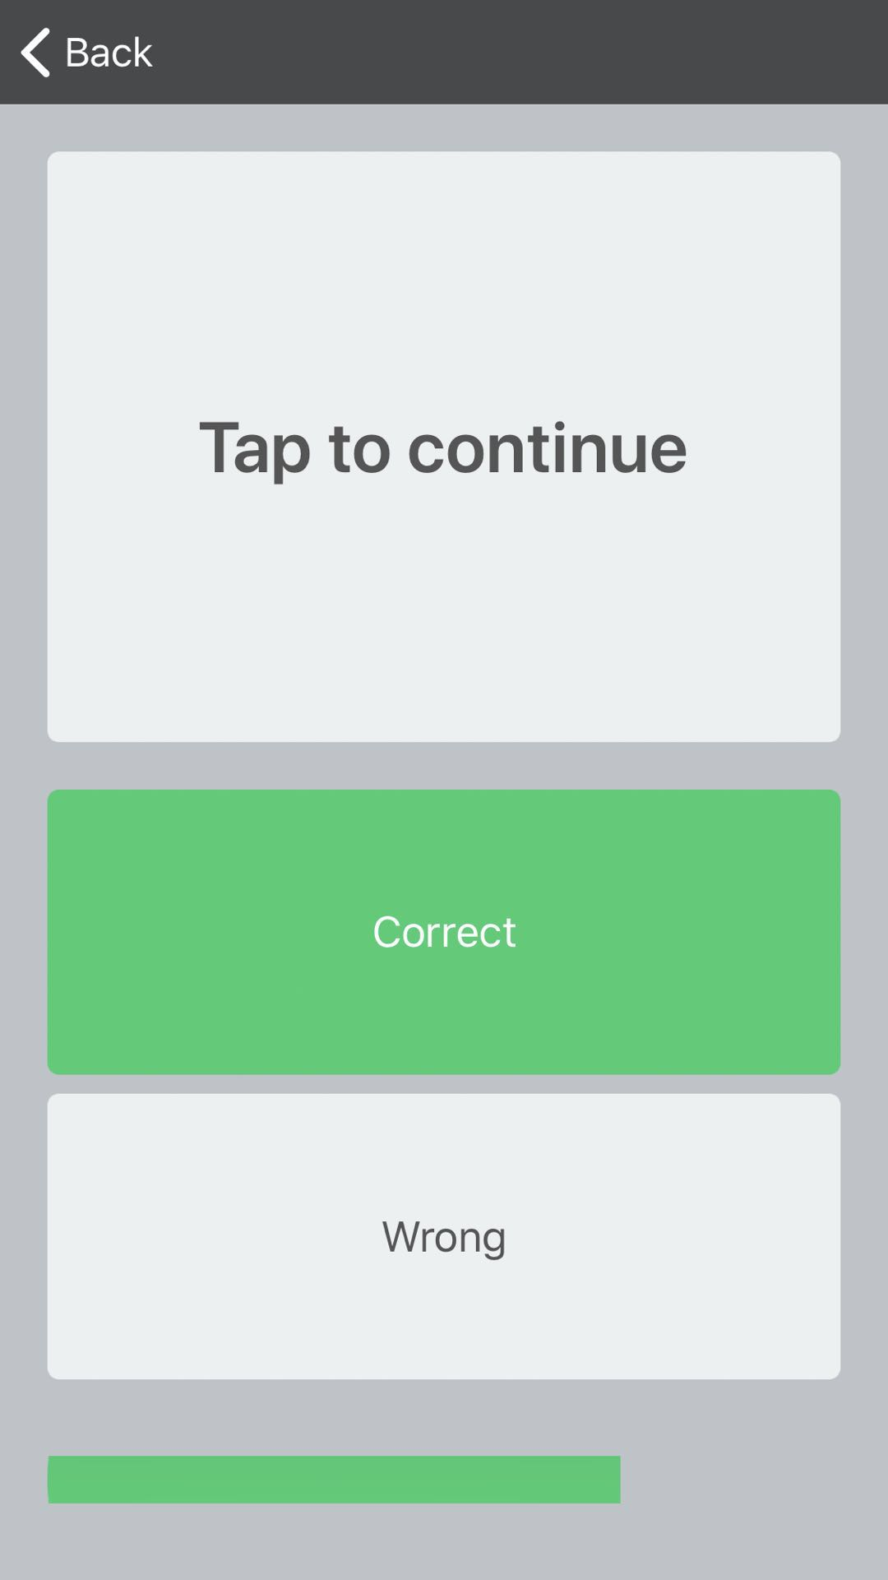
Quiz Categories
Right or Wrong Quiz
When the user entered ROW Quiz, they
can simply tap “Correct” or “Wrong”
button and if the user make a mistake,
ROW quiz will quit and back to app
homepage.
When the user give the right judgement
on the statement, ROW quiz will
continue by tapping upper section button.

Slide 5
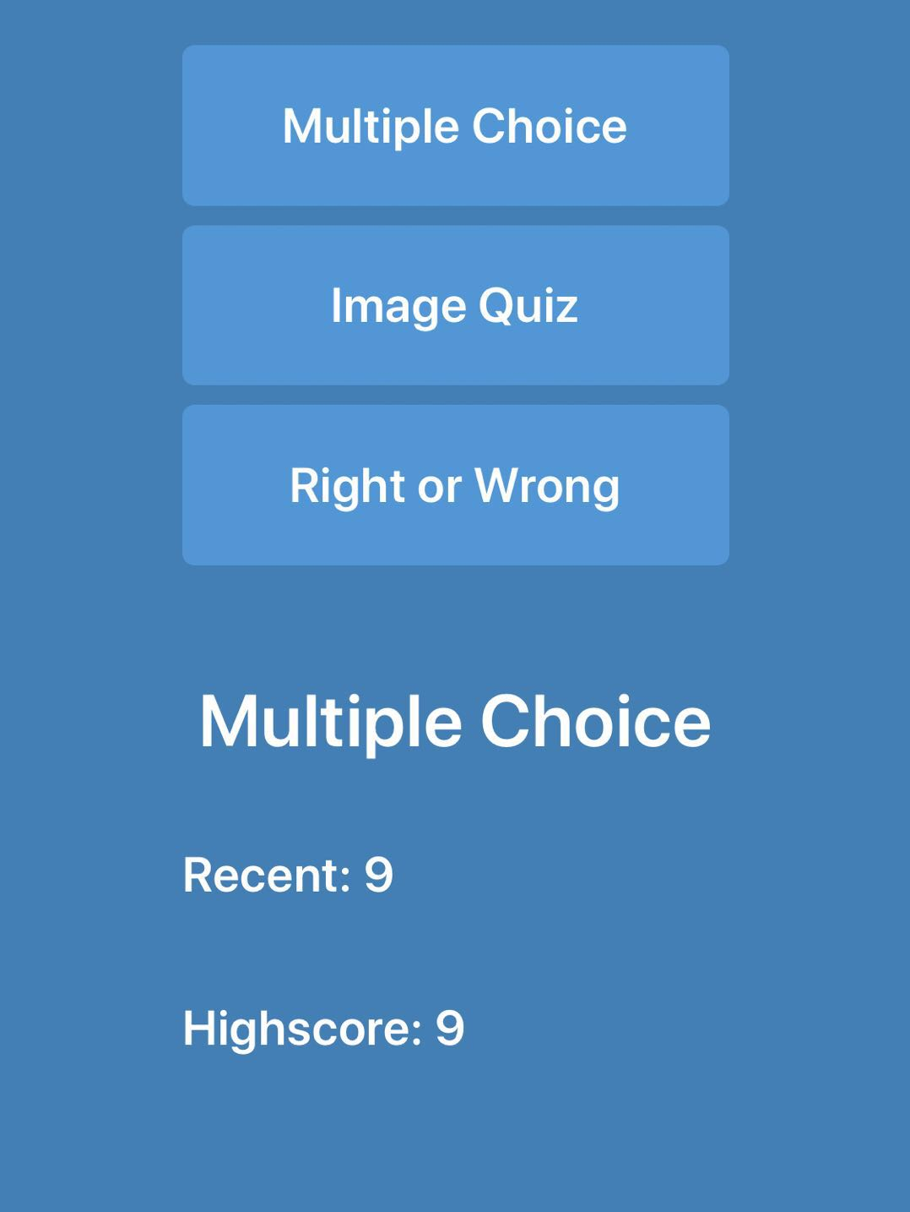
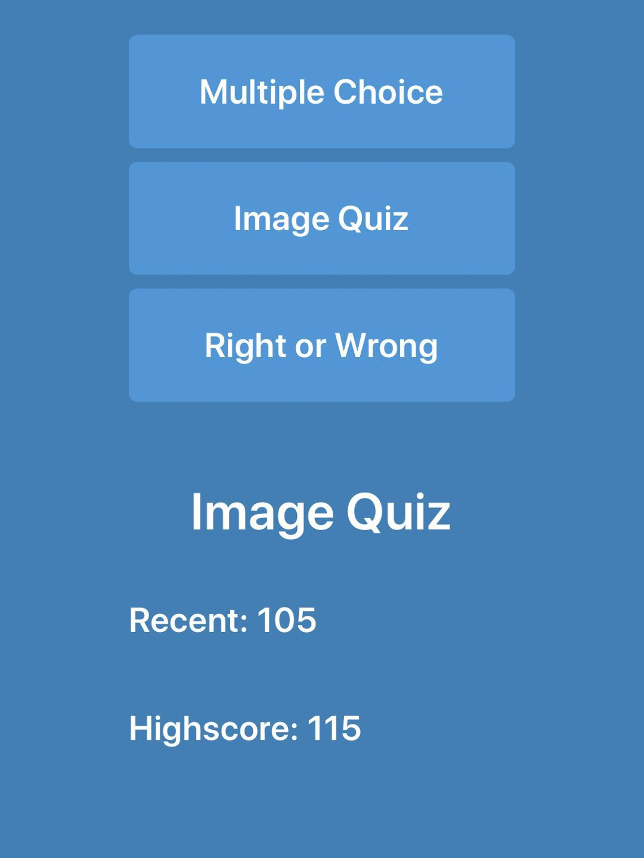
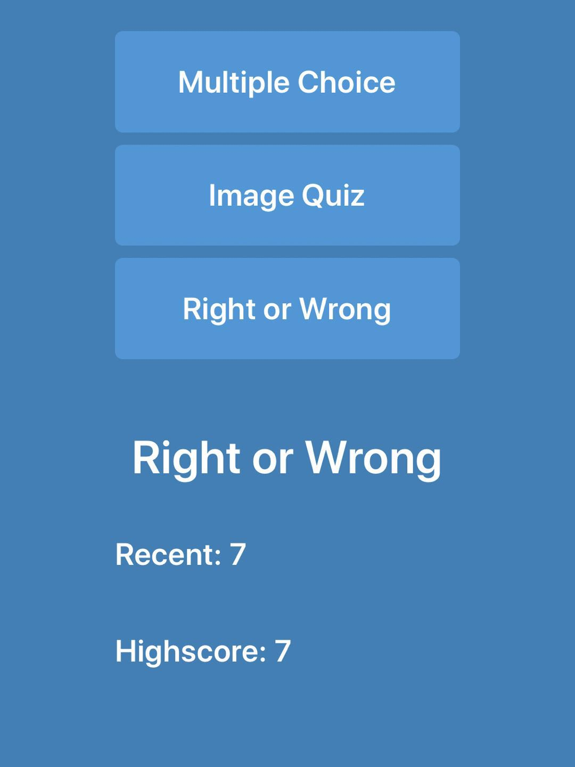
Results of Quiz
Outcome of Quiz(Highest score and Recent score)
Every time you end the quiz game, your recent score (the last time you tried) will show the bottom of the app homepage.

Slide 6
Summary
This app uses Auto layout but not storyboard to build whole layout,
so it can adapt variable Iphone on different inches in the market.
The structure of this quiz app is simple, due to limited time and shortage skills on using new programming language, Swfit, I have not
implemented some functionalities, such as “Less time more score”,
“Mark Ranking”, “Share outcomes by Facebook or other social media” and so on.

